Slide 1
Monetary Policy of India: A tug-of war between inflation control and growth
Presented by:-
Kriti Gupta (2015UCP1129)
Disha Agarwal (2015UCP1148)

Slide 2
Outline
Inflation
Economic Growth
How are the two related?
Conclusion I
Monetary Policies
How are the three correlated?
Example I
Example II
Conclusion II

Slide 3
Inflation
Inflation occurs due to an imbalance between demand and supply of money, changes in production and distribution cost or increase in taxes on products. When economy experiences inflation, i.e. when the price level of goods and services rises, the value of currency reduces. This means now each unit of currency buys fewer goods and services.

Slide 4

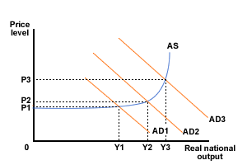

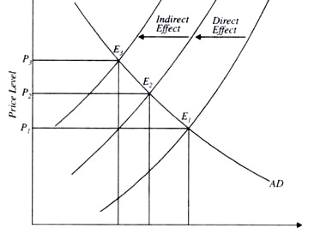
Types
Demand-pull
Supply-push
Monetary

Slide 5
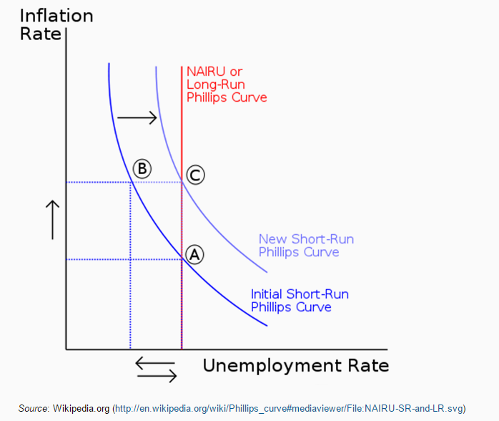
Philips Graph
Notes:
To be read

Slide 6
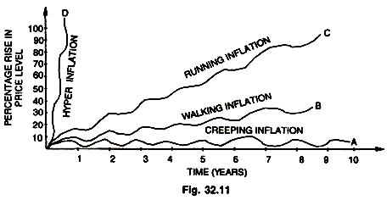
Variations

Slide 7
How to calculate it?
Consumer Price Index is calculated by collecting the Retail Cost of representative products or Services
Wholesale Price Index is calculated by monitoring the prices of certain goods that are traded at the Wholesale Market.
CPI = WPI + Transport Cost + Retailer’s Margin
Notes:
There is big difference in the Consumer Price Index and the Wholesale Price Index
CPI published every mnth
WPI published weekly
CPI
CPI is calculated by collecting the Retail Cost of representative products or Services from the following Categories for Urban Non-Manual Employees
Food, Beverages and Tobacco
Fuel and light
Housing
Clothing, Bedding and Footwear and
Miscellaneous
The weightage of each item and category is based on the type of family the CPI is being calculated.
There are many types of CPI
CPI Agricultural Labour
CPI Industrial Labour
CPI Urban Non-Manual Employees
Link to check out CPI Calculation Details http://mospi.nic.in/Mospi_New/up...
The weightage, categories and constituents differ for the different type of employees.
To check out the CPI Numbers current and historical use the link below
Labour Statistics Page 2
WPI
WPI is calculated by monitoring the prices of certain goods that are traded at the Wholesale Market.
There are 676 items that are monitored and there is a fixed weightage given to each group to arrive at the WPI.
It includes mining sector commodities as well as products made in the unregulated and regulated manufacturing sector. Total no of articles is 676
Main categories are
Primary Articles 102 articles weight 20.12
Food Primary 55 articles
Non-Food Primary 29 articles
Minerals 18 articles
Fuel Power Light and Lubricants 19 articles weight 14.23
Manufatured Products 555 articles weight 65.75
Links to check out WPI Calculation Details
http://www.eaindustry.nic.in/WPI...
http://mospi.nic.in/sites/defaul...
And the link below to see historical and present prices of the constituents of WPI and their weightage factor.
Office of the Economic Adviser
Essential Difference
CPI is the Index for Retail prices i.e. the price that comes out of the consumer’s pocket.
WPI is the Index for Wholesale Prices i.e. The amount that is paid to the Wholeseller.
Though not comparable as CPI includes services for the same item
CPI = WPI + Transport Cost + Retailer’s Margin.
The Transport Cost is dependent on Petrol Diesel Prices.
The Retailer’s Margin can not be predicted. It can be impacted by local demand and supply. It can be manipulated by Stockists.
Clearly CPI is the best measure of the cost of living of say an Agricultural Labour or an Industrial Labour. It should be referred to while adjusting wages to match with the cost of Living.
Rise and fall of both the Indices give a measure of the inflation in a Market.
However there may be a difference in the inflation calculated between the two as the constituents are different.
Thanks to comments from Ashutosh Gupta and Suman Gon I have changed the sentence below and added the link.
The Central Bank of India used to measure inflation based on WPI but under the Governorship of Dr Raghuram Rajan they switched to CPI.
On which Index India calculates its Inflation?
While there are many reasons for the switch, the WPI gives lesser weightage to Food Inflation. The WPI is not disturbed by local disturbances.

Slide 8
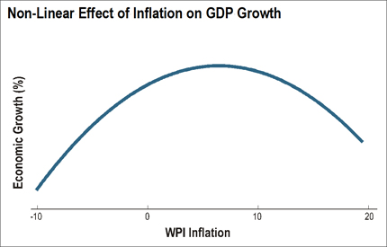
Threshold Inflation
“The relation between growth and inflation is non-linear,” former RBI Governor D. Subbarao said, “and there is a threshold below which there is a trade-off between growth and inflation. But above the threshold there is no trade-off.”
Source: reuters.com
Notes:
What he means is that a little inflation is good for growth; but when inflation exceeds a critical level inflation can actually come in the way of growth. Currently, RBI believes that the threshold is between 4-5%.

Slide 9
Economic Growth
Economic growth is an increase in the capacity of an economy to produce goods and services, compared from one period of time to another. It can be measured in nominal or real terms, the latter of which is adjusted for inflation.
Notes:
Kriti

Slide 10
How are the two related?
Inflation-Growth

Slide 11
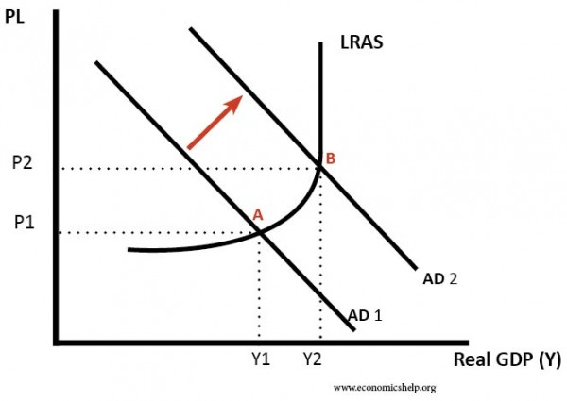
High growth and high inflation
If economic growth is above the average sustainable rate of growth over a period of time (long run trend rate) then inflation is likely to occur.
Source: economicshelp.org
Notes:
UK Lawson Boom 1980
If demand rises faster than firms can increase supply, firms will respond to the excess demand and supply constraints by putting up prices.
In a period of rapid growth, firms will employ more workers and unemployment will fall. As unemployment falls, firms may find it harder to fill job vacancies; this shortage of labour will cause wages to rise.
If wages rise, firms costs increase and therefore firms pass these cost increases on to consumers.
Also, with rising wages, workers have more disposable income to spend – causing a further rise in aggregate demand (AD)
With higher economic growth, people may start to expect inflation – and this expectation of rising prices can become self-fulfilling.
Therefore, rapid economic growth tends to cause upward pressure on prices and wages – leading to higher inflation rate.

Slide 12
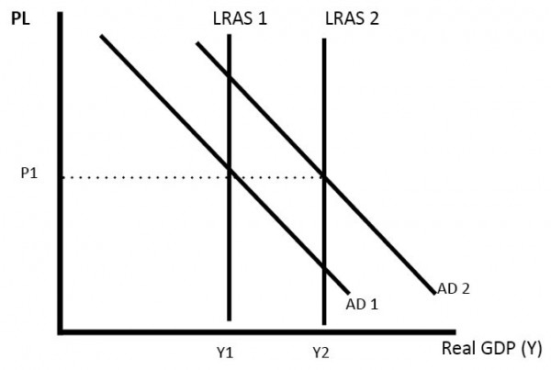
High Growth and Low Inflation
If growth is caused by increased productivity and investment, then the productive capacity of the economy can increases.
Source: economicshelp.org
Notes:
It is possible that we can have economic growth without causing inflation.
If this rate is proportional to that of aggregate demand, then this enables economic growth without inflation. It is the best possible scenario.

Slide 13
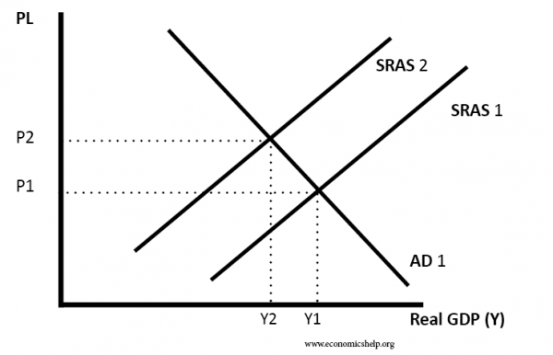
High Inflation and Low Growth
This can occur if there is cost push inflation. Cost push Inflation could be caused by rising oil prices. It increases costs for firms and reduces disposable income. Therefore, there is lower growth, whilst high inflation. This is sometimes known as stagflation.
Source: economicshelp.org

Slide 14
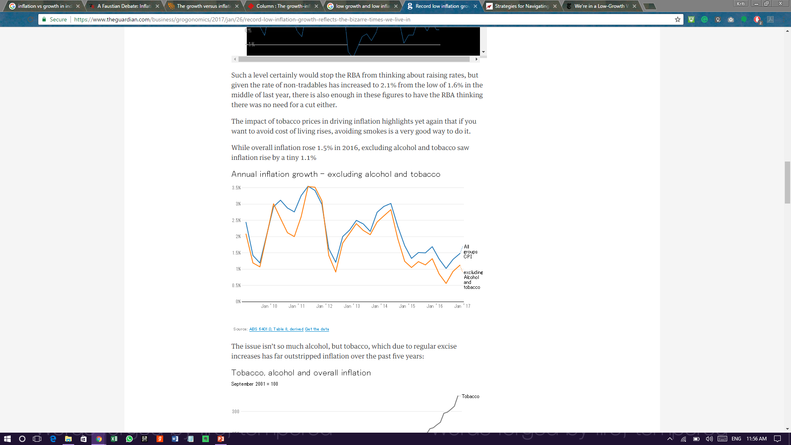
Low Inflation and Low Growth
When the demand falls and hence so does the supply, the prices too reduce. Also, there is no development of various sectors. Therefore, the economy is stagnant.
Source: https://www.theguardian.com/
Notes:
Australia 2017
USA – 81% flat or declining income
Fewer working hours, lesser output

Slide 15
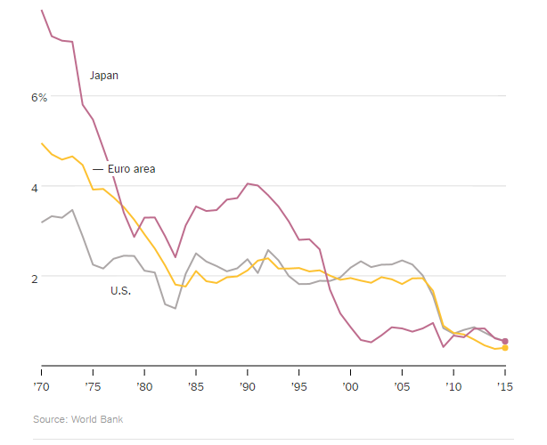

Slide 16
Conclusion I
There can be a conflict between economic growth and inflation. In periods of rapid economic growth, inflation is likely to rise. However, it is possible to have both low inflation and positive economic growth – so long as the growth is sustainable and productive capacity increases at similar rate to AD.

Slide 17
Monetary Policy
Monetary Policy
Currency
Deposits
Credit
Foreign Exchanges
Monetary policy is the macroeconomic policy laid down by the central bank. It involves management of money supply and interest rate and is the demand side economic policy used by the government of a country to achieve macroeconomic objectives like inflation, consumption, growth and liquidity.

Slide 18
Features
Objectives
Active Policy
Controlled Money Supply
Seasonal Variations
Flexible
Investment & Saving Oriented
Wide Range of Methods of Credit Control
Neutrality of Money
Exchange Rate Stability
Economic Growth
Price Stabilization
Full Employment
BOP Equilibrium
Equal Income Distribution
Notes:
Active policy – current policy, former – passive policy
Neutrality of money is the change in money supply whish affects nominal variables and not real ones

Slide 19
Quantitative
Qualitative
Bank Rate
Open Market Operations
Repo Rate & Reverse Repo Rate
Liquidity Adjustment Facility (CRR & SLR)
Rationing of Credit
Margin Requirement
Variable Interest Rate
Regulation of Consumer Credit
Licensing
Notes:
BR is the rate at which Central Bank lends money to commercial Banks. Any increase in Bank rate results in an increase in interest rate charged by Commercial banks which in turn leads to low level of investment and low inflation
OMOs are the means of implementing monetary policy by which a central bank controls the nation’s money supply by buying and selling government securities, or other financial instruments
Repo - Repurchase Agreement
RR is the interest rate at which the central bank lends funds to banks against pledging securities. RR>>, banks get less money
RRR is the rate at which RBI borrows money from the banks. RRR>> banks have less money.
Reverse repo rate signifies the rate at which the central bank absorbs liquidity from the banks, while repo signifies the rate at which liquidity is injected.
CRR refers to the cash which banks have to maintain with RBI as certain percentage of their demand and time liabilities. An increase in CRR reduces the cash with commercial banks which results in low supply of currency in the market, higher interest rate and low inflation
SLR is the percentage of total deposits commercial banks have to invest in government bonds and other approved securities. Objectives - To restrict expansion of Bank credit, to augment bank’s investment in government securities, and to ensure solvency of banks

Slide 20
How are the three correlated?
Inflation-Growth-Monetary Policies

Slide 21
Monetary Policy Tools
Used as an effective tool to target economic growth.
Used mainly to control money supply
Money supply
Determines the total amount of currency floating in the economy.
Is considered as a major factor for inflation and Growth
Inflation & Growth
Rise/fall in general price level
Affects the economic growth of the country
Notes:
As it can be seen by this linked list, monetary policy tools have a direct impact on money supply, which in turn affects levels of inflation and growth.

Slide 22
Tight Monetary Policy
Govt. sells Securities (OMO)
CRR, Repo Rate, Bank Rates
Monetary Supply
Interest Rates
Investment Expenditures
Aggregate Demand
Price Level
Expansionary Monetary Policy
Govt. buys Securities (OMO)
CRR, Repo Rate, Bank Rates
Monetary Supply
Interest Rates
Investment Expenditures
Aggregate Demand
Aggregate Supply
Source: RBI Reports
Notes:
Tight – reduce money flow
Expansionary – increase money flow
Government buys securities, using OMOs. Cash Reserve Ratio, repo rate, bank rate decrease, therefore money supply increases and interest rate decreases, which leads to increase in investment expenditures, aggregate demand and supply.

Slide 23
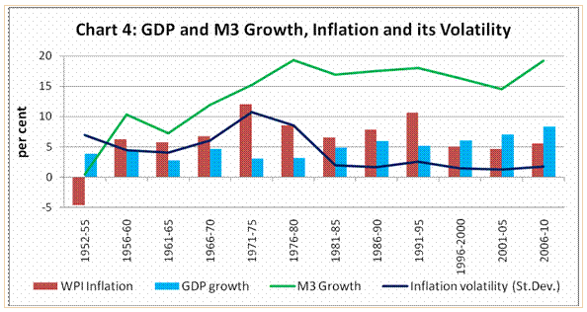
Source: trsdingeconomics.com
Notes:
M1-M4
M0 and M1, also called narrow money, normally include coins and notes in circulation and other money equivalents that are easily convertible into cash. M2 includes M1 plus short-term time deposits in banks and 24-hour money market funds. M3 includes M2 plus longer-term time deposits and money market funds with more than 24-hour maturity. The exact definitions of the three measures depend on the country. M4 includes M3 plus other deposits. The term broad money is used to describe M2, M3 or M4, depending on the local practice.

Slide 24
Example I
India during 2008-12
Notes:
To corroborate our stance, affect on Indian economy due to global recession in 2008

Slide 25
Remedy by RBI and its consequences
It was in March 2010 that the RBI increased the repo in quick steps from 4.5% to 8.75%. Meanwhile, GDP growth dropped from 9% to 5.3%.
In 10 out of 22 industry groups in the manufacturing sector, production declined in May. Investment in new projects dropped from 3.1 trillion rupees in the quarter ending June 2011 to 1.9 trillion rupees in the quarter ending June 2012.
Notes:
High inflation, low growth
But inflation did not respond.
The fall in GDP growth has been almost exclusively due to the stagnancy in industry. While agriculture and services more or less maintained their pace, industrial growth dropped sharply. Industry is driven by demand. When demand is strong, it will use capacity fully and go in for additional investment. When demand is weak, production is reduced.
This was a period of high inflation, low growth. But, why?

Slide 26
Problem
It s because the rise in prices of agricultural consumer products, for which demand is very inelastic, diverted a part of consumer expenditure from industry to agriculture. Demand for industry dropped and it was forced to cut production.
Notes:
It is no wonder that the repo rate failed to curb inflation. Although inflation was subdued towards the end of 2011 and the beginning of 2012, it was because of increase in agricultural production.

Slide 27
Solution
If an increase in repo failed to curb inflation, would a cut in repo have pulled up industrial growth? Perhaps it would have because the lower rate of interest would divert a part of the income from savings to consumption.
Notes:
Not because the consumer expenditure on agriculture would have been reduced but because the lower rate of interest would divert a part of the income from savings to consumption. Demand for industrial goods would have been revived and growth would have picked up even though inflation was beyond the threshold level.

Slide 28
Example II
Demonetization
Notes:
Low Inflation, Low growtb

Slide 29
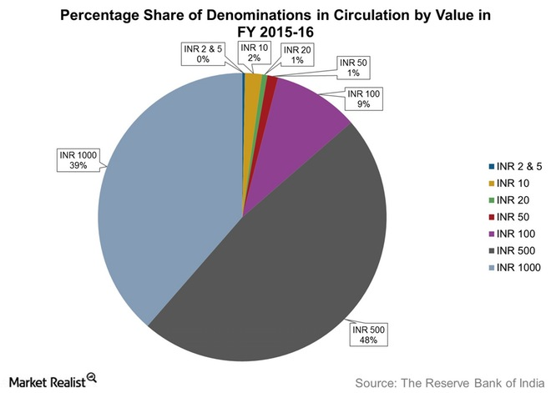
Notes:
86.4%

Slide 30
Impact
Activity in the real estate sector, which includes a lot of cash and undocumented transactions, slowed down significantly, Metropolitan and Tier 1 cities reported up to a 30% fall in house prices.
The supply and demand of food items fell. It will exert more downward pressure on inflation.
Notes:
The demonetization that has been in effect since November 9 is expected to have a negative impact on inflation. Consumer spending activity fell to a near halt. Consumers are refraining from making any purchases except essential items from the consumer staples, healthcare, and energy segments.
Food item inflation, measured by changes in the Consumer Food Price Index, accounts for 47.3% of the overall CPI. Due to 86.4% of the value of the currency notes in circulation going out of the financial system and re-monetization being slow,.

Slide 31
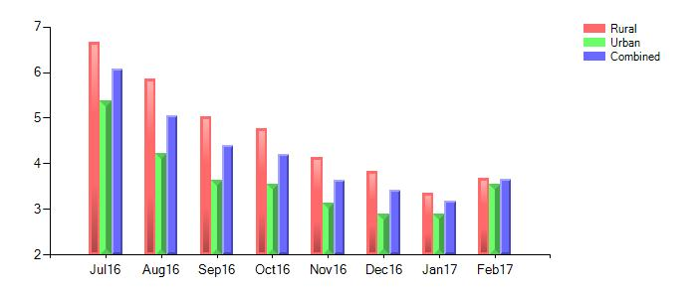
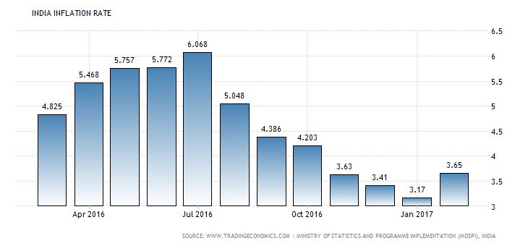
Source: Statistics & Programme Implementation,Govt. of India

Slide 32
Conclusion II
Our final thoughts
Notes:
After a tiring match of tug-of-war between inflation control and growth in Indian economy with monetary policy being the referee, let us look at the results.

Slide 33
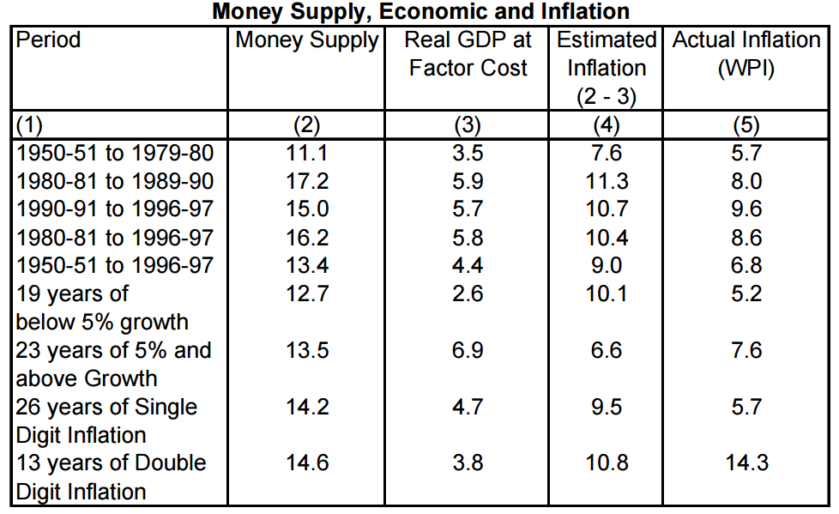
Earlier Scenario
Notes:
More focus on Inflation control, rather than economic growth
As can be seen from this table, between 1950-1997, it was necessary to bring down inflation with the worries of economic growth taking a backseat. This was a period of high inflation and low growth.

Slide 34
Current Scenario
Bank Rate - 6.75 %
Cash Reserve Ratio (CRR) - 4 %
Statutory Liquidity Ratio (SLR) - 20.50 %
Repo Rate (RR) - 6.25 %
Reverse Repo Rate (RRR) - 5.75 %
Marginal Standing Facility (MSF) - 6.75 %
Base rate: 9.25/9.65%
Savings Deposit rate: 4%
Term deposit rate>1 year: 7.5 %.
Growth forecast: 7.6%
Inflation - 7.5%
Policy Repo rate - 6.25
Savings Deposit rate - 4%
Notes:
The current scenario of 2017 looks like this, where both inflation and growth rate are high. This is unstable in the long run and we need to take steps to move towards low inflation and high growth period.

Slide 35
India should move forward as times change and so should its policies.
Inflation control was the need of the hour in the beginning years of our independence, but it is high time now that we shift our focus towards increasing productivity and hence our economic growth.
Notes:
We, as citizens of this nation, ask if a policy announced allows industry to make better capital allocation decisions over the long term. Ad hoc exemptions and tax rate changes may provide temporary relief, but not sustainable growth. Investment requires a stable policy environment. Fickle decision making does not work - not even favorable decisions. Foreign investment may receive favors. Policy makers would do well to remember that foreign savings make up less than 10 per cent of the total saving in the country. Undue focus on international capital flows while neglecting domestic markets does not make sense. Money has the same color - irrespective of its origin. Real reform for India would be reducing the size of government expenditure and not by raising user prices. The government has created a list of entitlements and threatens to create more without debating. How these will be paid for.? Last year, the finance minister promised not to have costs off the "balance sheet". He failed. Let's wish for a better year ahead. Else, the Indian growth story will remain the best potential play - only the potential will take another decade to realize.

Slide 36
Bibliography
www.investopedia.com
https://rbi.org.in
www.rediff.com/business
www.economictimes.com
www.tradingeconomics.com
www.statisticstimes.com
www.reuters.com
https://www.theguardian.com/
www.economicshelp.org

Slide 37
Thank You!

